Slide 1
임베디드시스템설계및실험
DMA (Direct Memory Access)

Slide 2
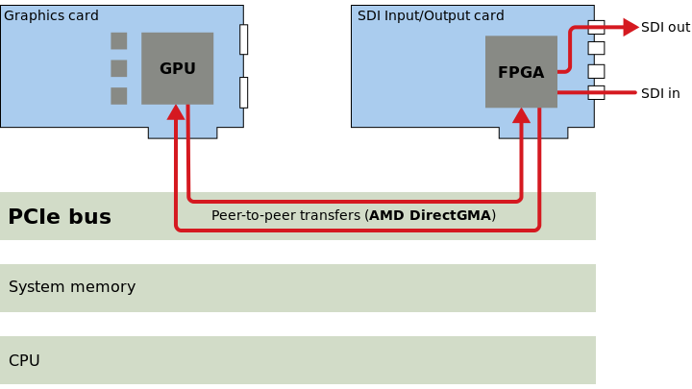
Direct Memory Access
DMA introduction
to provide high-speed data transfer between peripherals and memory
data can be quickly moved by DMA without any CPU actions

Slide 3
Direct Memory Access
DMA main features
12 independently configurable channels
each of the 12 channels is connected to dedicated hardware DMA requests
priorities between requests from channels of one DMA are software programmable
independent source and destination transfer size (byte, half word, word)
support for circular buffer management
3 event flags
DMA Half Transfer, DMA Transfer Complete and DMA Transfer Error
memory-to-memory transfer
peripheral-to-memory, memory-to-peripheral and peripheral-to-peripheral
programmable number of data to be transferred: up to 65536

Slide 4
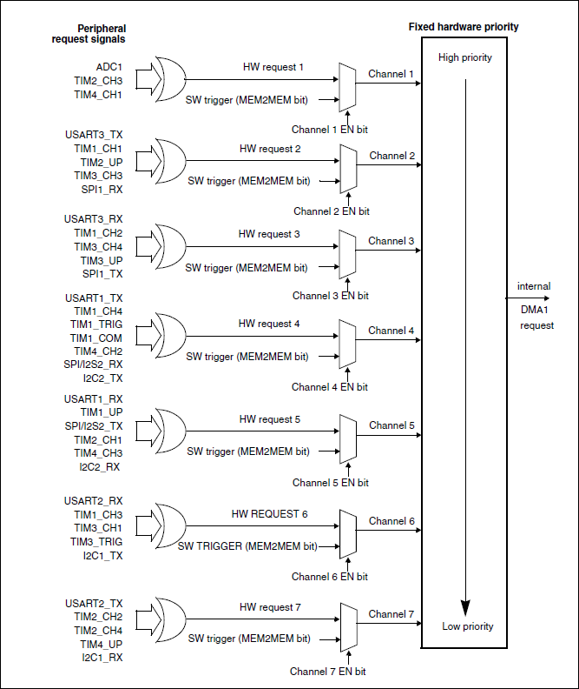
Direct Memory Access
DMA request mapping
DMA1 controller
the 7 requests from the peripherals (TIMx[1,2,3,4], ADC1, SPI1, SPI1/I2S2, I2Cx[1,2,] and USARTx[1,2,3]) are simply logically ORed before entering the DMA1
only one request must be enabled at a time

Slide 5
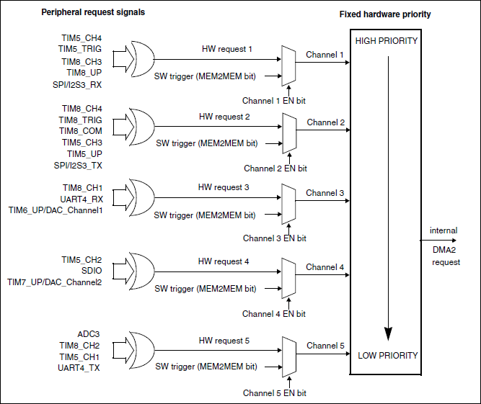
Direct Memory Access
DMA request mapping
DMA2 controller
the 5 requests from the peripherals (TIMx[5,6,7,8], ADC3, SPI/I2S3, USART4, DAC_Channel[1,2] and SDIO) are simply logically ORed before entering the DMA2
only one request must be enabled at a time

Slide 6
Direct Memory Access
see stm32f10x_dma.c and stm32f10x_dma.h
DO NOT HAVE TO use interrupt
수업 발표 내용
DMA 정의, 동작 방법, 효과
보드에서의 DMA 동작 및 사용 방법
실험 방법
조사하여 발표

